Slide 1


Workshop Blazor & ABP
Creating an Event/Meetup Application
https://github.com/hikalkan/presentations

Slide 2
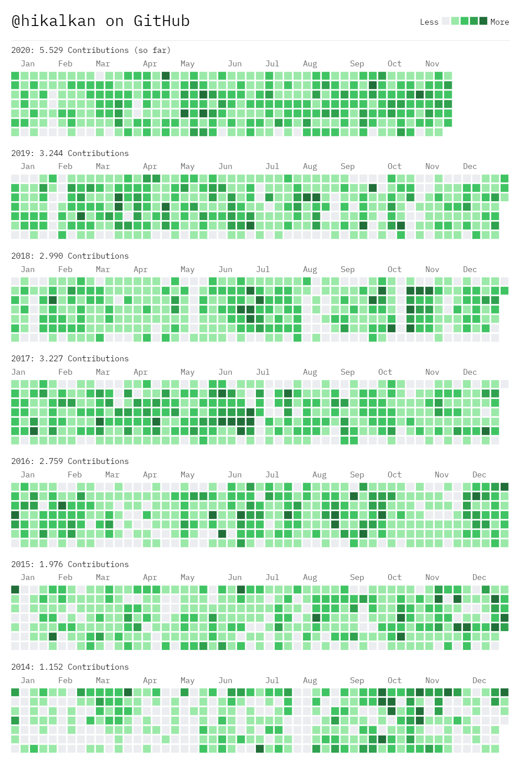


ABOUT ME Halil İbrahim Kalkan
Co-Founder of
Web: halilibrahimkalkan.com
Github: @hikalkan
Twitter: @hibrahimkalkan

Slide 3
What is Blazor?
Pros
C# instead of JavaScript
.NET platform runs on the Browser over WebAssembly
All the .NET Ecosystem (NuGet packages) in the client side!
Code sharing (DTOs, validation logic, utils…) between client & server.
JavaScript Interop
Cons
Initial Load & Runtime performance
Limited Debugging
UI Component libraries are not mature & rich.

Slide 4
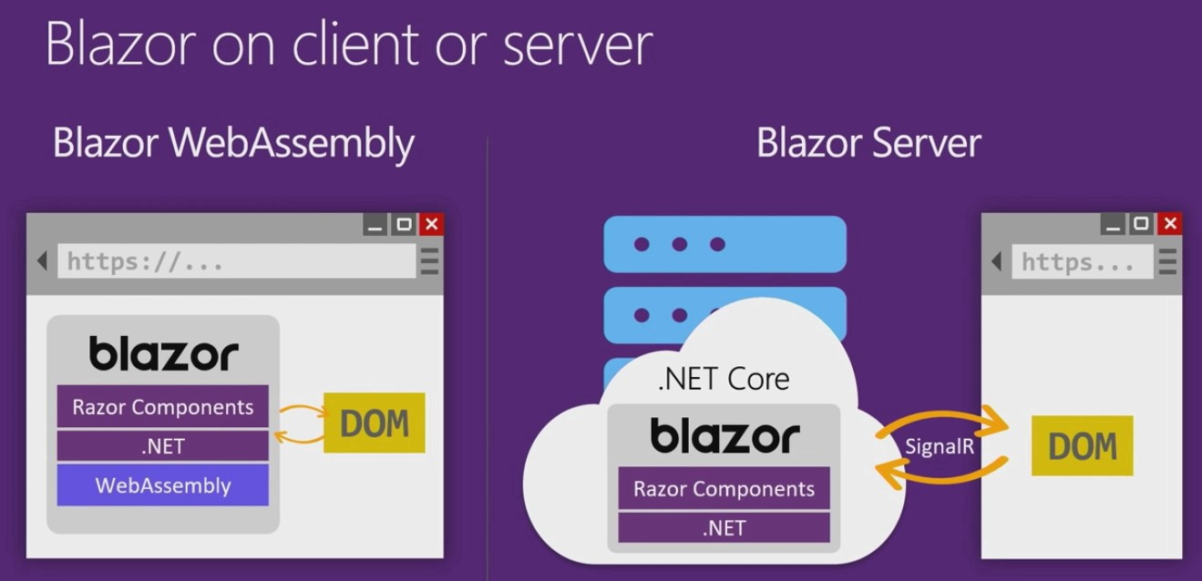

Slide 5
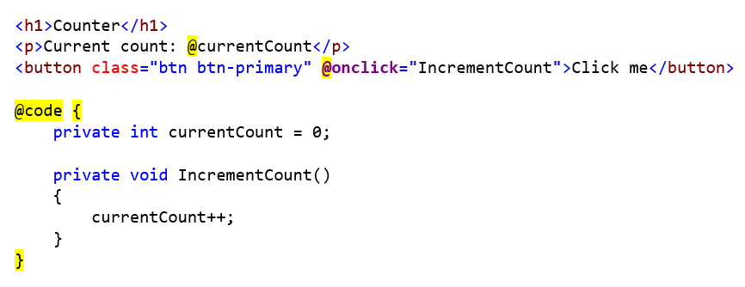
Blazor: Razor Components

Slide 6
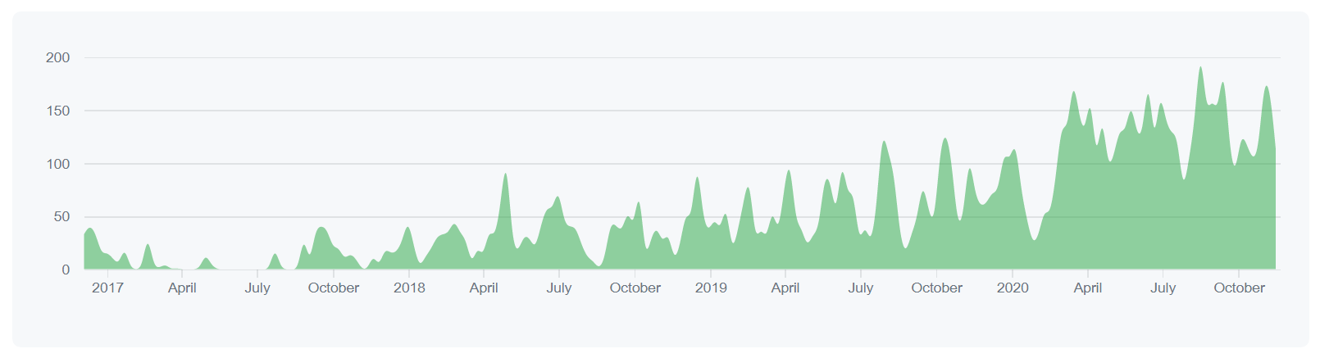
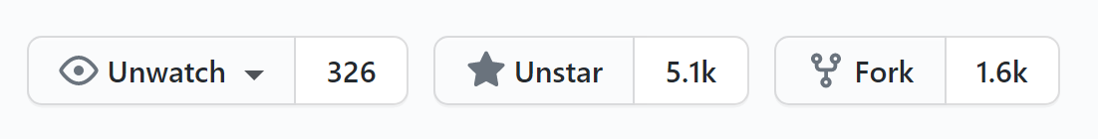
What is the ABP Framework? abp.io | github.com/abpframework
A complementary framework to ASP.NET Core for real-life solutions.
Complete architecture & infrastructure
Modular & microservice compatible
Multi-Tenancy (for SaaS solutions)
Developer friendly

Slide 7
The Application / Tooling
Tooling
.NET 5.0 & ASP.NET Core 5.0 as the base framework
ABP Framework as the application framework
Blazor as the UI framework
Blazorise as a component library (Bootstrap compatible)
MongoDB as the database provider

Slide 8
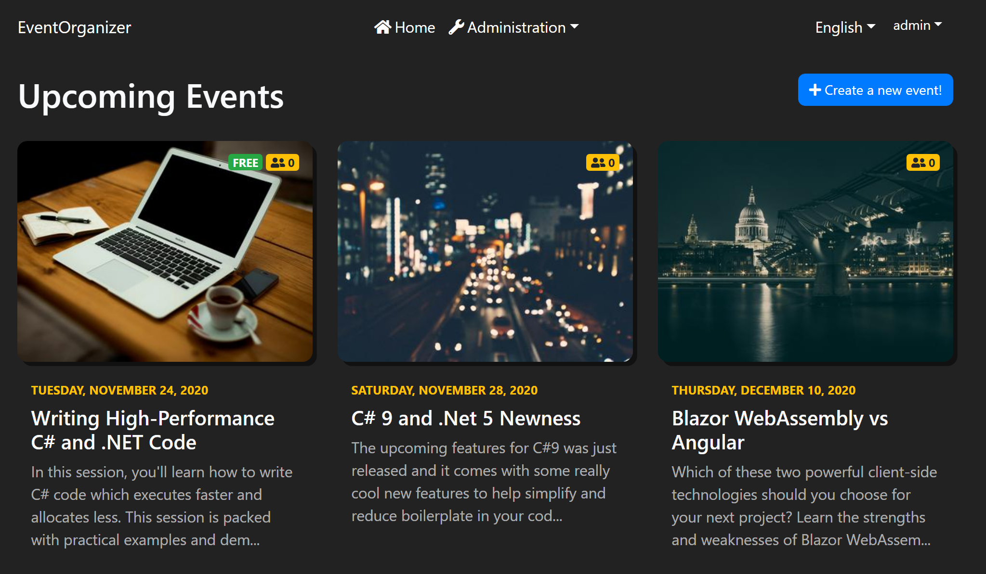
The Application / Event List (Home Page)

Slide 9
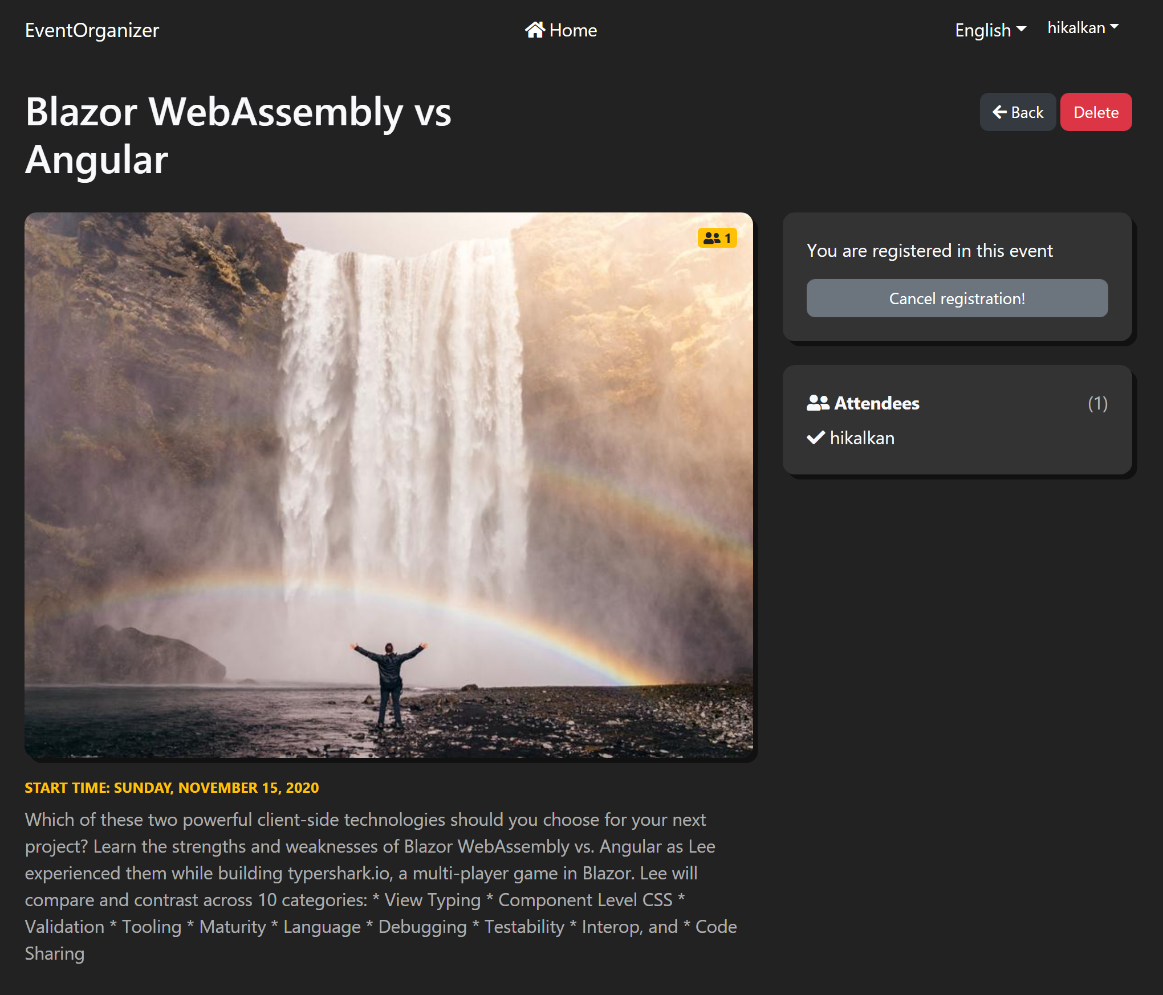
The Application / Event Detail

Slide 10
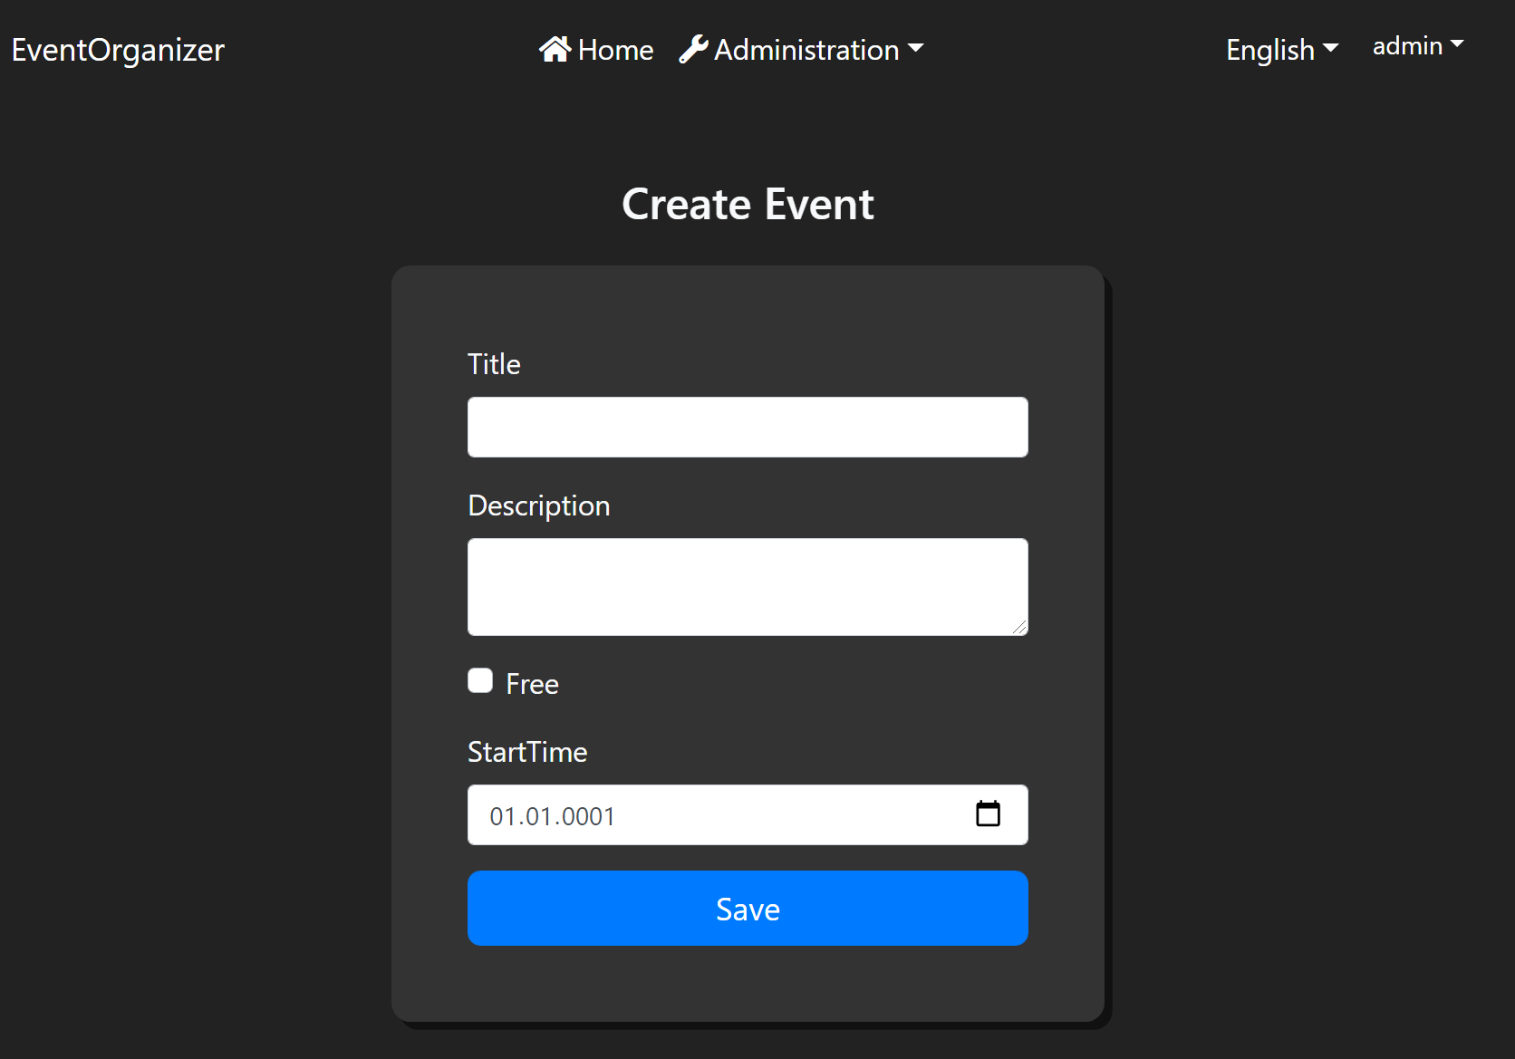
The Application / Create Event

Slide 11
The Application
Live Coding!

Slide 12
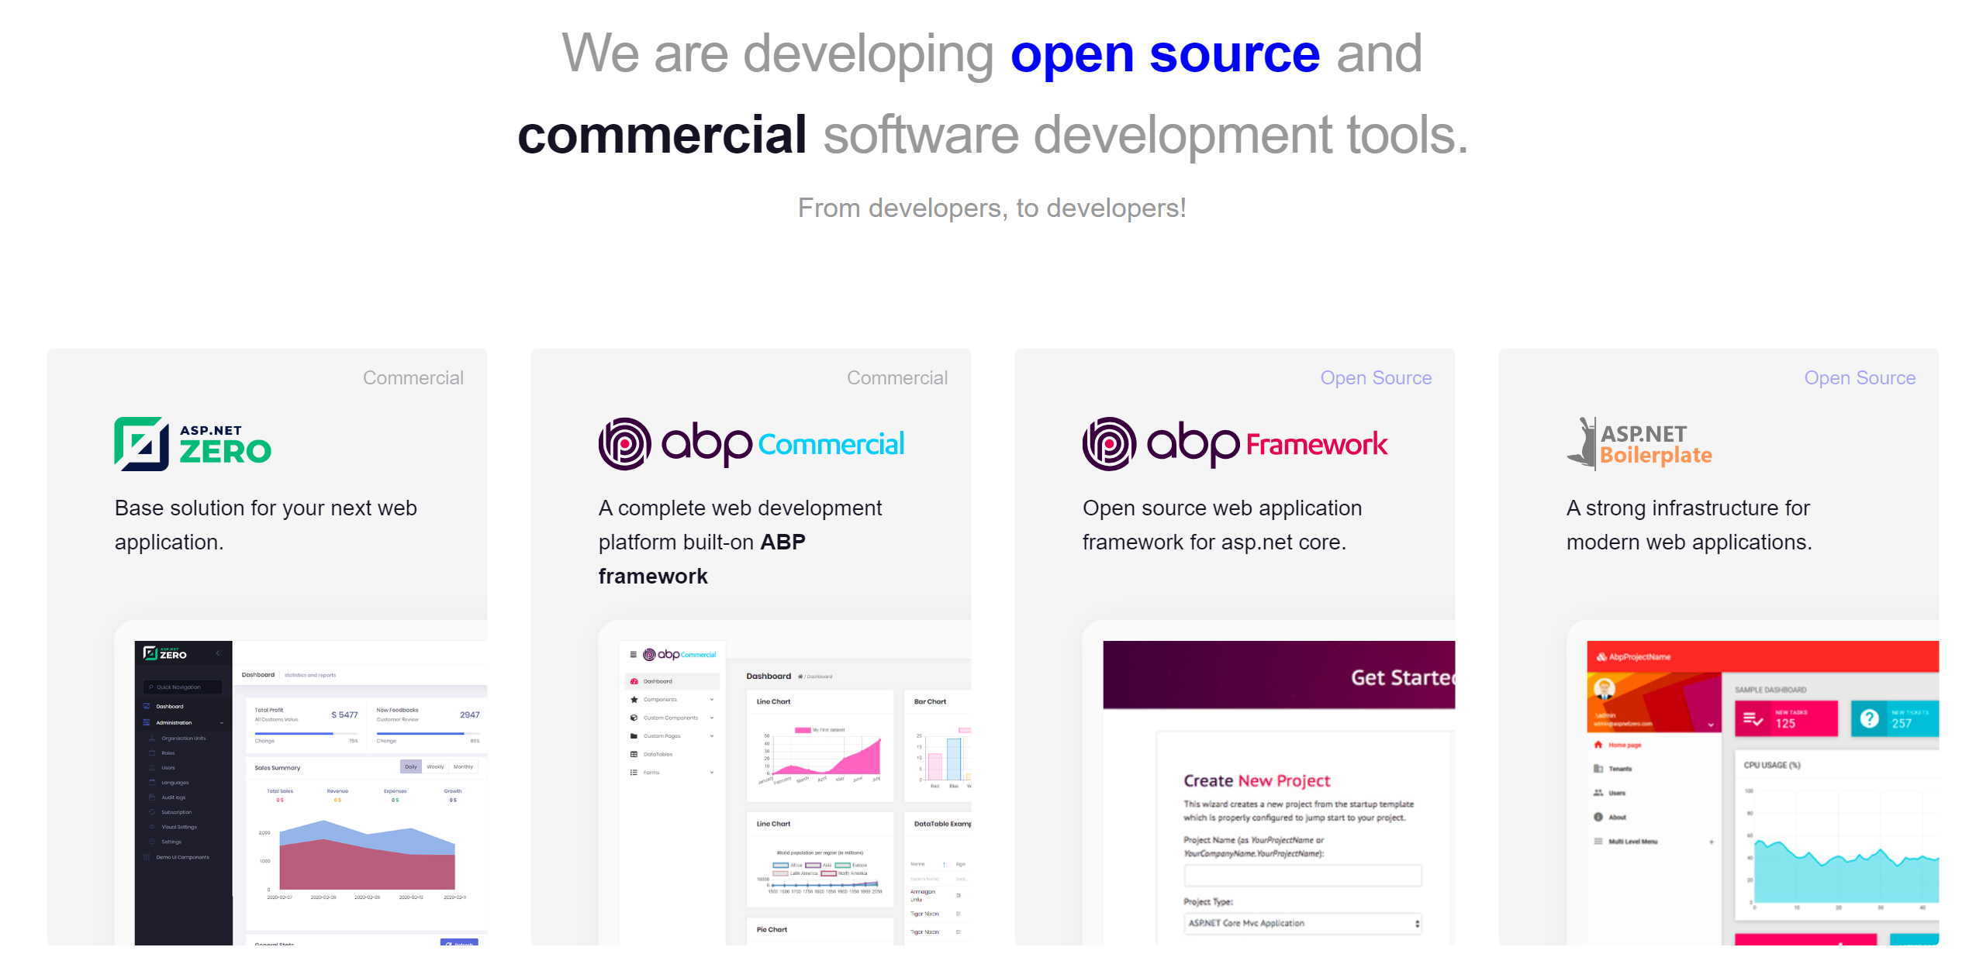
volosoft.com/career

Slide 13
Thanks!
The Presentation https://github.com/hikalkan/presentations
The Source Code http://bitly.com/abp-event-organizer (https://github.com/abpframework/abp-samples/tree/master/EventOrganizer)
Github: @hikalkan
Twitter: @hibrahimkalkan

